Slide 1
Lecture 6:
Dynamic Array and Amortized Analysis
Keren Zhu
kerenzhu@cse.cuhk.edu.hk

Slide 2
Topics in this lectures
Dynamic array
  Maybe the most commonly used data structures in everyday programming
  std::vector, java.util.ArrayList, list in Python, etc.
Introduction to amortized analysis
  Won’t be in the exam
  Common techniques: aggregate analysis, the accounting method and the potential method
  Read more in Sec. 16 in CLRS

Slide 3
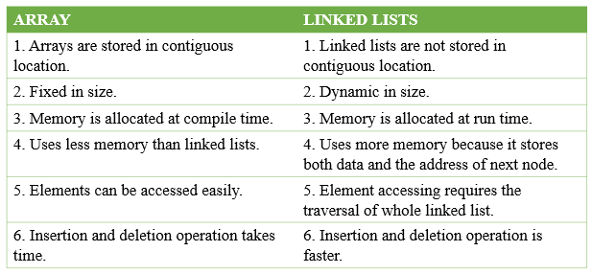
Pros and cons of array
Array is fixed allocation of memory
An array implementation for Stack ADT has undefined behavior if full

Slide 4
Exceptions for a full queue
The case where the array is full is not an exception defined in the stack ADT
If the array is filled, we have five options:
  Throw an exception
  Ignore the element being pushed
  Replace the current top of the stack
  Put the pushing process to “sleep” until something else removes
  the top of the stack
  Increase the size of the array -> Dynamic array
Insert/append need to handle increasing memory if needed

Slide 5
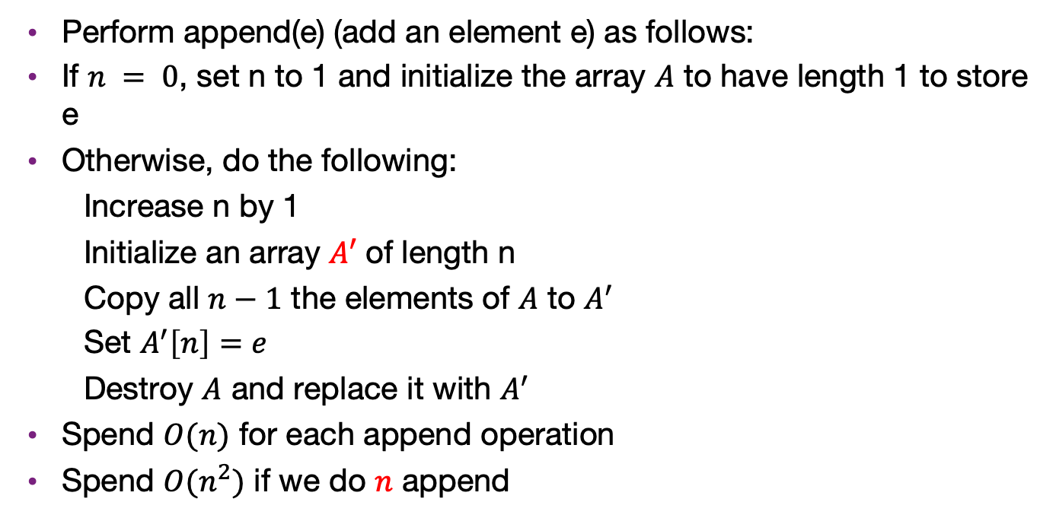
A naïve algorithm
Perform append(e) (add an element e) as follows:
If $n = 0$, set n to 1 and initialize the array $A$ to have length 1 to store e
Otherwise, do the following:
  Increase n by 1
  Initialize an array $A^{′}$of length n
  Copy all $n−1$ the elements of $A$ to $A^{′}$
  Set $A^{′}\left[n\right]=e$
  Destroy $A$ and replace it with $A^{′}$
Spend $O(n)$ for each append operation
Spend $O(n^{2})$ if we do $n$ append

Slide 6
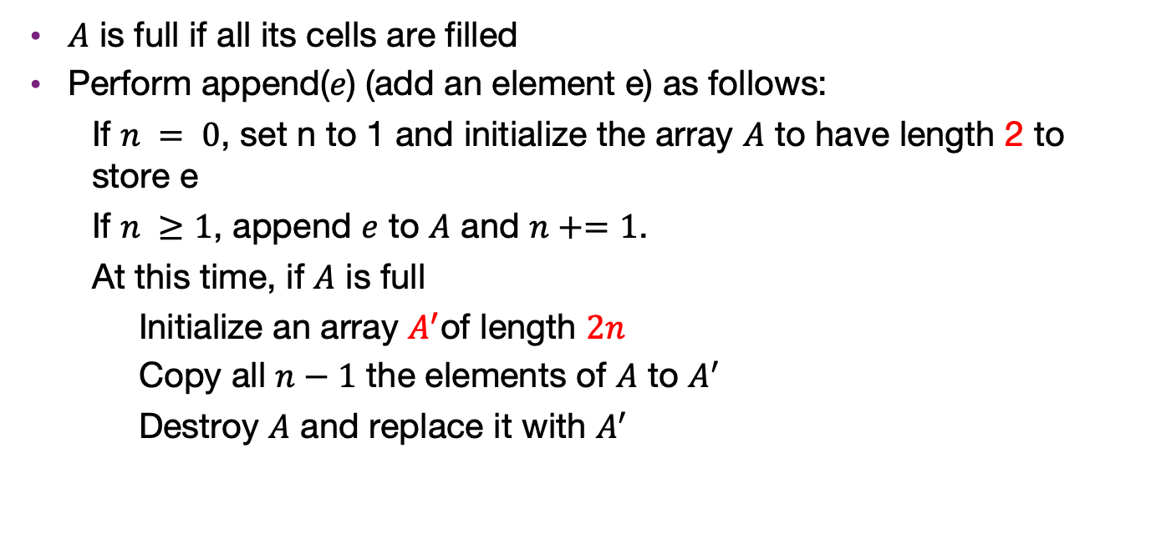
A better algorithm
$A$ is full if all its cells are filled
Perform append($e$) (add an element e) as follows:
  If $n = 0$, set n to 1 and initialize the array $A$ to have length 2 to store e
  If $n ≥1$, append $e$ to $A$ and $n+=1$.
  At this time, if $A$ is full
  Initialize an array $A^{′}$of length $2n$
  Copy all $n−1$ the elements of $A$ to $A^{′}$
  Destroy $A$ and replace it with $A^{′}$

Slide 7
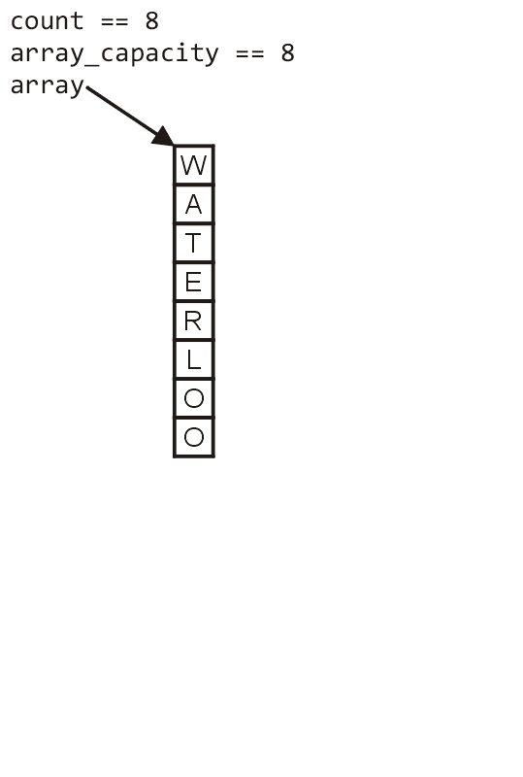
Dynamic array example
First, let us visualize what must occur to allocate new memory

Slide 8
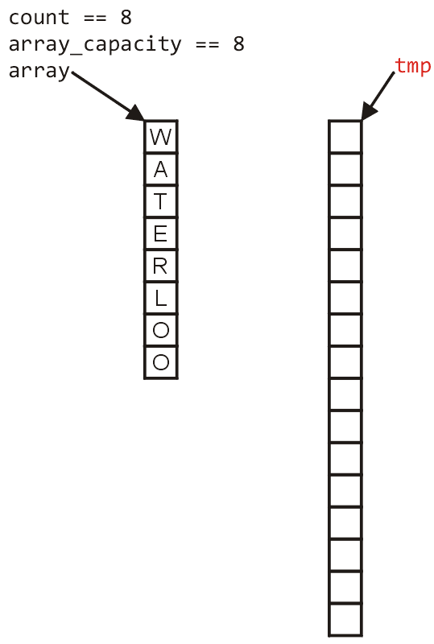
Dynamic array example
First, this requires a call to new Type[N] where N is the new capacity
  We must have access to this so we must
  store the address returned by new in a
  local variable, say tmp

Slide 9
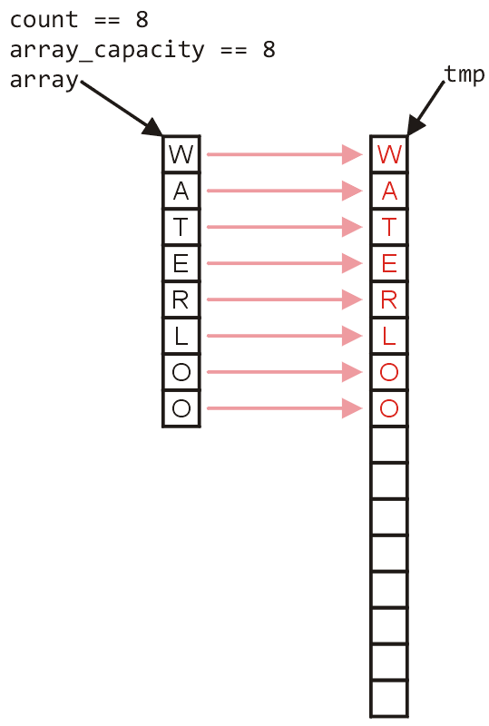
Dynamic array example
Next, the values must be copied over

Slide 10
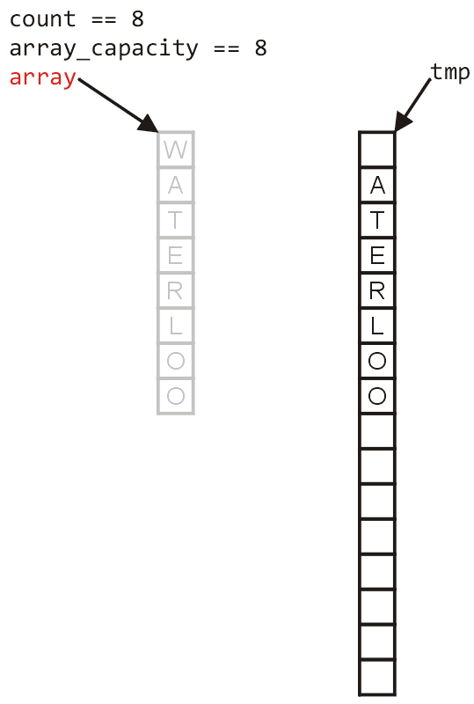
Dynamic array example
W
The memory for the original array must be deallocated

Slide 11
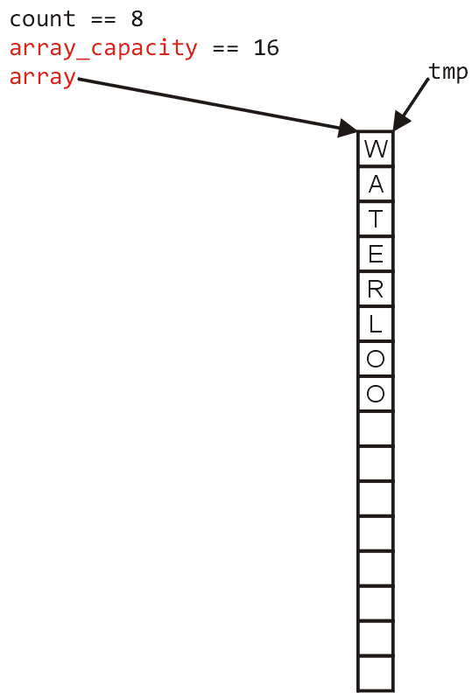
Dynamic array example
Finally, the appropriate member variables must be reassigned

Slide 12

Analyze its runtime
Cost of appending the n-th element:
  If A is not full
  $O(1)$
  If A is full
  $O\left(n\right)$ (need to copy n elements)

Slide 13
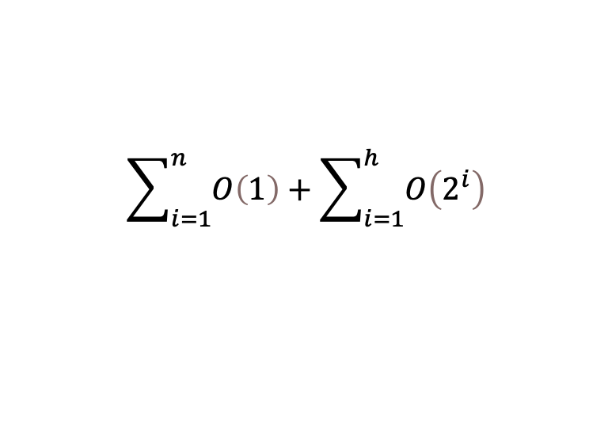
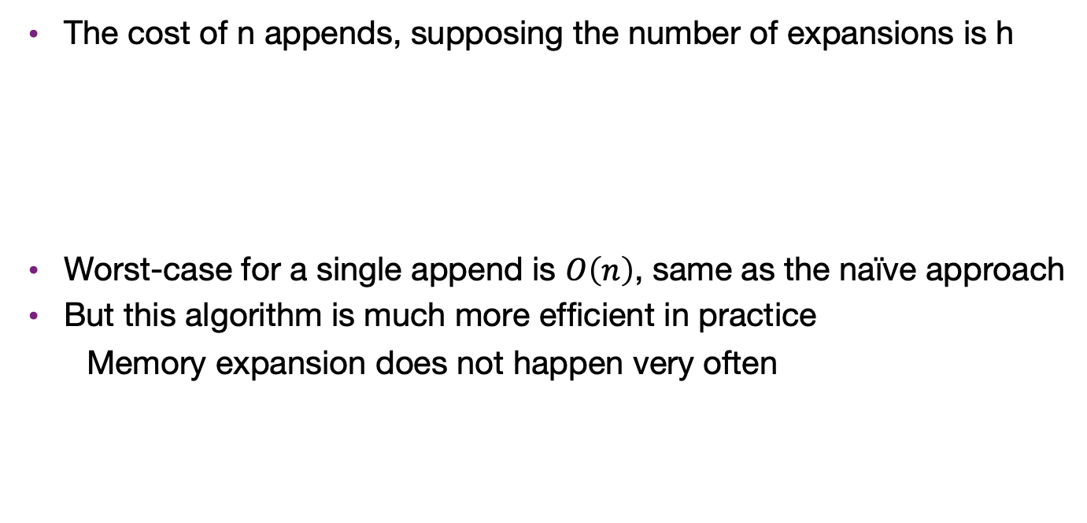
The total cost of n appends
The cost of n appends, supposing the number of expansions is h
Worst-case for a single append is $O\left(n\right)$, same as the naïve approach
But this algorithm is much more efficient in practice
  Memory expansion does not happen very often
$$\sum_{i=1}^{n}{O\left(1\right)}+\sum_{i=1}^{h}{O\left(2^{i}\right)}$$

Slide 14
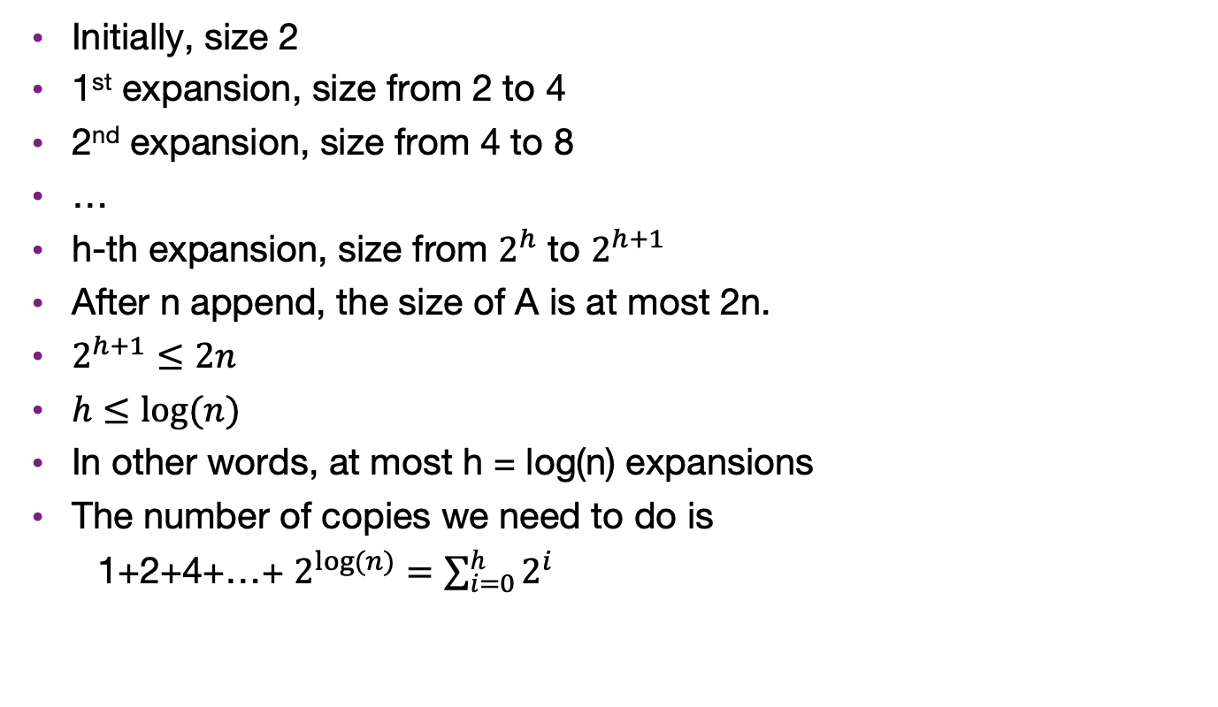
Array expansions
Initially, size 2
1st expansion, size from 2 to 4
2nd expansion, size from 4 to 8
…
h-th expansion, size from $2^{h}$ to $2^{h+1}$
After n append, the size of A is at most 2n.
$2^{h+1}≤2n$
$h≤log⁡(n)$
In other words, at most h = log(n) expansions
The number of copies we need to do is
  1+2+4+…+ $2^{log⁡(n)}=\sum_{i=0}^{h}{2^{i}}$

Slide 15
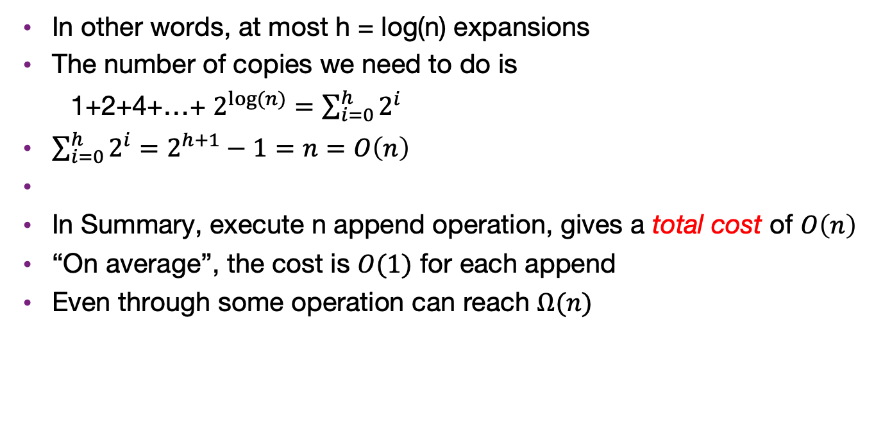
Array expansions
In other words, at most h = log(n) expansions
The number of copies we need to do is
  1+2+4+…+ $2^{log⁡(n)}=\sum_{i=0}^{h}{2^{i}}$
$\sum_{i=0}^{h}{2^{i}}=2^{h+1}−1=n=O\left(n\right)$
In Summary, execute n append operation, gives a total cost of $O\left(n\right)$
“On average”, the cost is $O(1)$ for each append
Even through some operation can reach $Ω(n)$

Slide 16
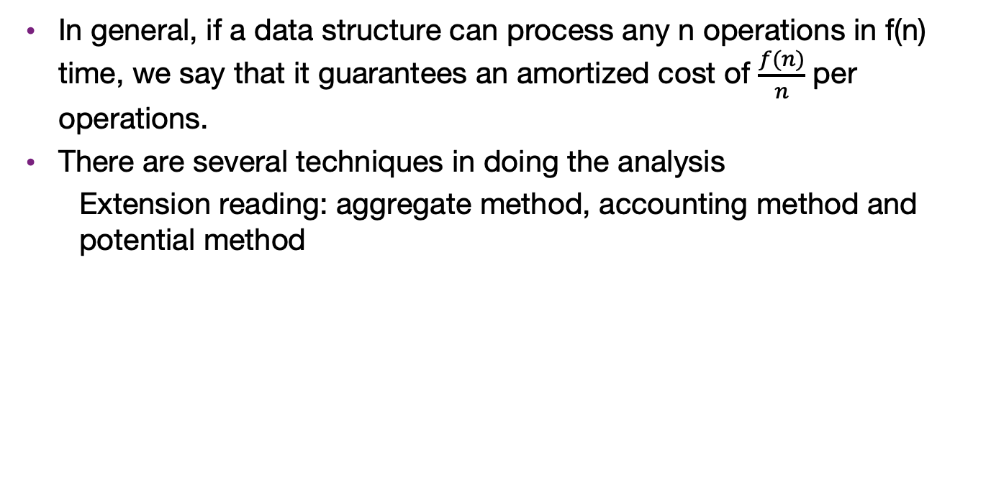
Amortized cost
In general, if a data structure can process any n operations in f(n) time, we say that it guarantees an amortized cost of $\frac{f(n)}{n}$ per operations.
There are several techniques in doing the analysis
  Extension reading: aggregate method, accounting method and potential method

